Slide 1
Checkpoint #12
Number your paper 1-7….Slide times will vary depending of type of question

Slide 2
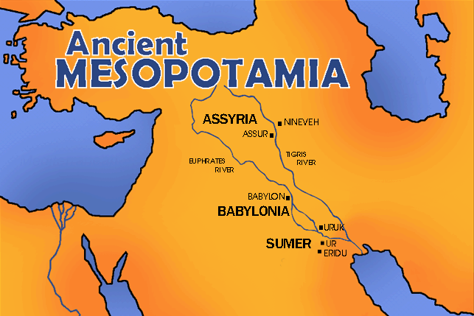
Which modern day country was once know as Mesopotamia?…….. – 6.8
Iran
Saudi Arabia
Iraq
Jordan

Slide 3
In the quote below, what region is being referenced?- 6.8
Fertile Crescent
Egypt
Mesopotamia
The middle East
“The name of the third river is Tigris; it flows east of Assyria. And the fourth river is the Euphrates.” – Genesis 2:14…The Garden of Eden

Slide 4
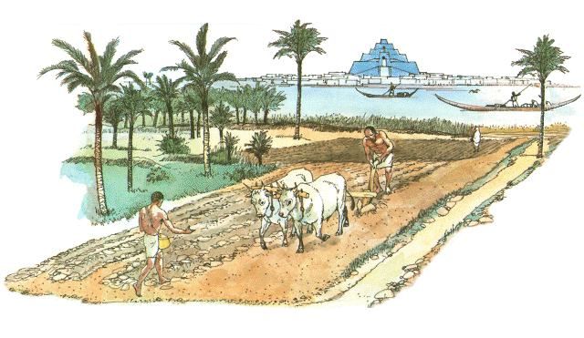
3. What is the importance of the Sumerian civilization? 6.9
Historians consider it the oldest civilization
They created the world’s first permanent armies.
Historians consider them to be the first great empire of the world
They developed the alphabet

Slide 5
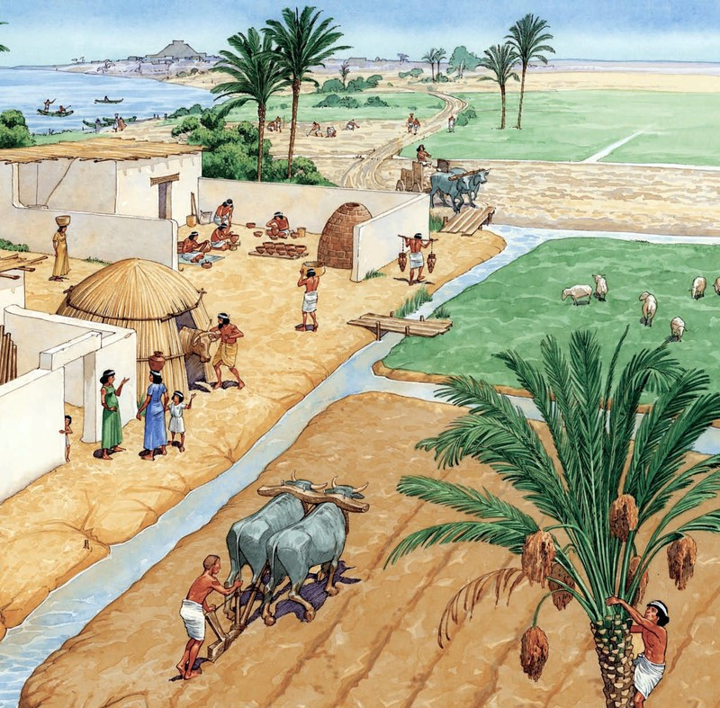
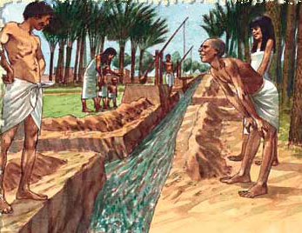
4. What activity below allowed for farmers to create a surplus of food? – 6.10
domestication
irrigation
Metallurgy
Herding

Slide 6
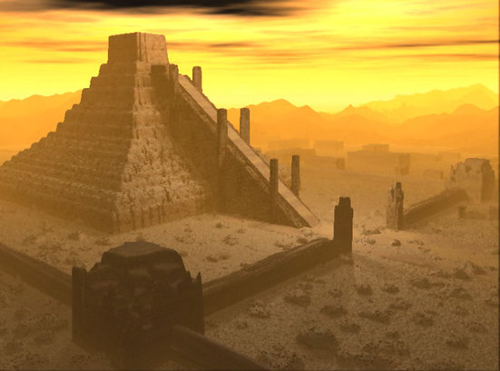
5. Early civilizations’ religious beliefs were polytheistic in nature. What did the early Sumerians believe their gods had control over? – 6.11
Elements in nature…fire, wind, and water…
Blessings and guiding people in their daily lives
Deciding which person was to rule over the land.
All of the above.

Slide 7
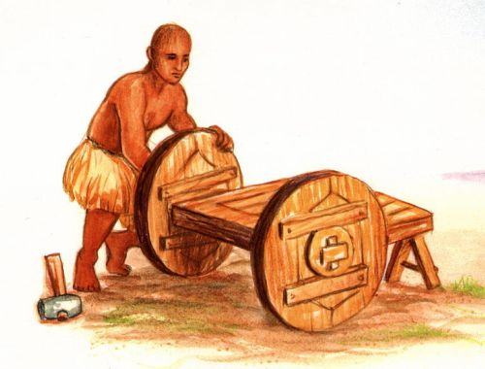
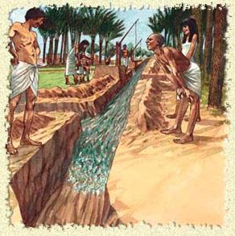
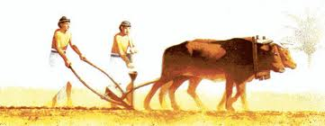
6. The following illustrations effected what aspect of Sumerian culture the most? - 6.12
Agriculture
Herding
Trade
Metallurgy

Slide 8
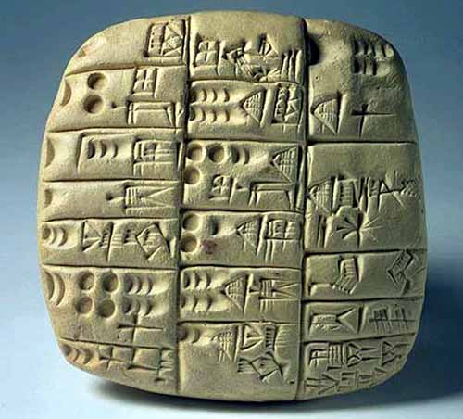
7. Earliest scribes in Mesopotamia recorded trade by developing the world’s oldest written system. Identify the writing system.
Cuneiform
Hieroglyphics
Pictographs
Alphabet

Slide 9
Check your answers

Slide 10
Which modern day country was once know as Mesopotamia?…….. – 6.8
Iran
Saudi Arabia
Iraq
Jordan

Slide 11
In the quote below, what region is being referenced?- 6.8
Fertile Crescent
Egypt
Mesopotamia
The middle East
“The name of the third river is Tigris; it flows east of Assyria. And the fourth river is the Euphrates.” – Genesis 2:14…The Garden of Eden

Slide 12
3. What is the importance of the Sumerian civilization? 6.9
Historians consider it the oldest civilization
They created the world’s first permanent armies.
Historians consider them to be the first great empire of the world
They developed the alphabet

Slide 13
4. What activity below allowed for farmers to create a surplus of food? – 6.10
domestication
irrigation
Metallurgy
Herding

Slide 14
5. Early civilizations’ religious beliefs were polytheistic in nature. What did the early Sumerians believe their gods had control over? – 6.11
Elements in nature…fire, wind, and water…
Blessings and guiding people in their daily lives
Deciding which person was to rule over the land.
All of the above.

Slide 15
6. The following illustrations effected what aspect of Sumerian culture the most? - 6.12
Agriculture
Herding
Trade
Metallurgy

Slide 16
7. Earliest scribes in Mesopotamia recorded trade by developing the world’s oldest written system. Identify the writing system.
Cuneiform
Hieroglyphics
Pictographs
Alphabet

