Slide 1
Checkpoint #13
Number your paper 1-7….Slide times will vary depending of type of question

Slide 2
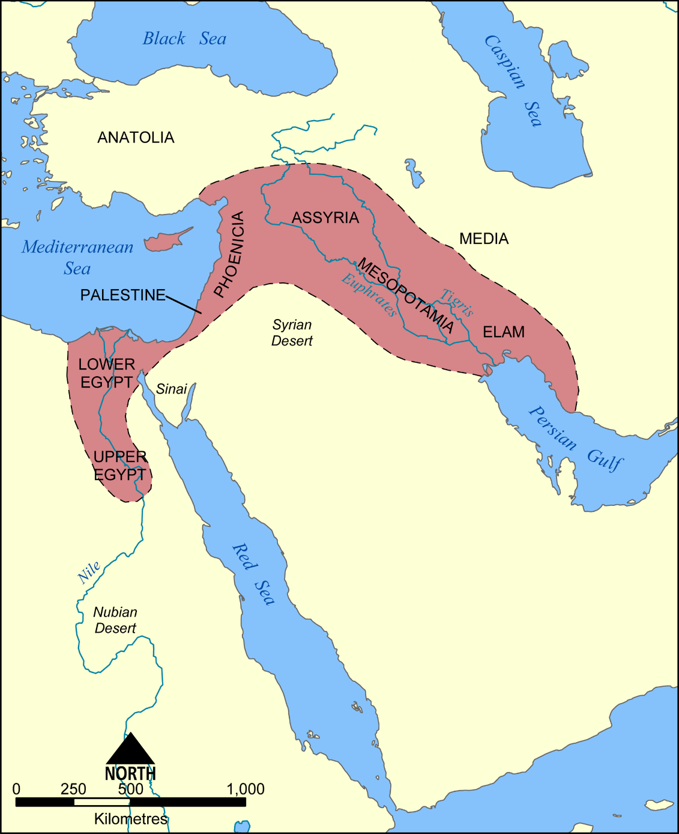
The highlighted region refers to… – 6.8
Middle East
Mesopotamia
Fertile Crescent
Near East

Slide 3
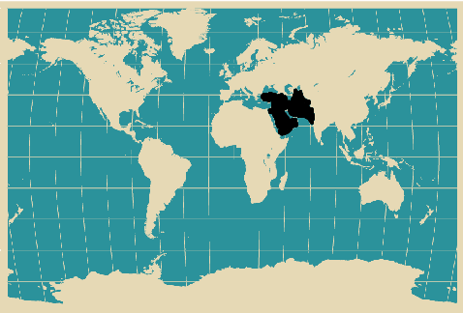
Identify the highlighted region. – 6.8
Middle East
Fertile Crescent
Far East
Central Asia

Slide 4
3. According to the timeline which civilization was the oldest? 6.9
Sumerians
Akkadians
Hittites
Assyrians

Slide 5
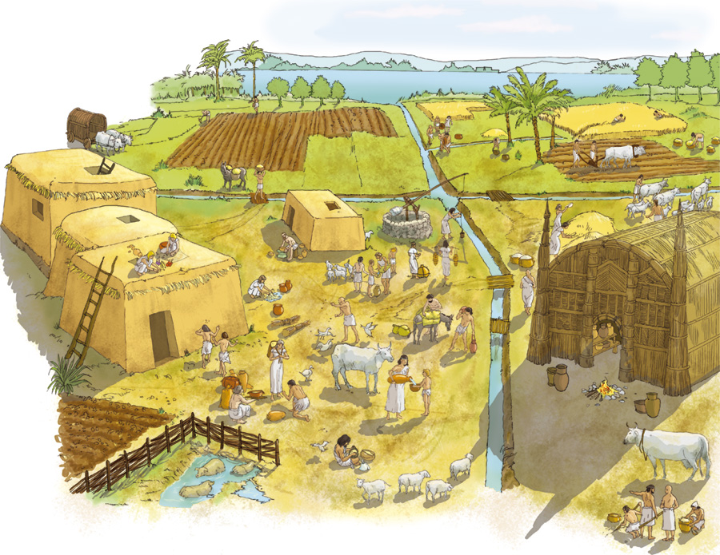
4. Canals, dams, and basins are….. – 6.10
Innovations used in transpiration
Innovations in metallurgy
Innovation that helped created food surplus
Innovation in forging

Slide 6
According to this excerpt, what “evil thing” did the gods decide in their assembly? - 6.11
 | a. | to destroy their people
 | b. | to tremble and weep
 | c. | to turn to stone
 | d. | to beat animals

Slide 7
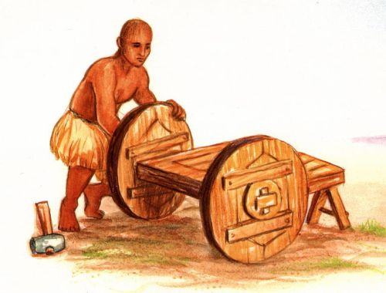
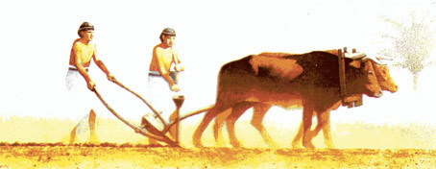
6. Which of the following has the greatest effect in movement? - 6.12
Wheel
Plow
Calendar
Geometry

Slide 8
- 6.13

Slide 9
Check your answers

Slide 10
The highlighted region refers to… – 6.8
Middle East
Mesopotamia
Fertile Crescent
Near East

Slide 11
Identify the highlighted region. – 6.8
Middle East
Fertile Crescent
Far East
Central Asia

Slide 12
3. According to the timeline which civilization was the oldest? 6.9
Sumerians
Akkadians
Hittites
Assyrians

Slide 13
4. Canals, dams, and basins are….. – 6.10
Innovations used in transpiration
Innovations in metallurgy
Innovation that helped created food surplus
Innovation in forging

Slide 14
According to this excerpt, what “evil thing” did the gods decide in their assembly? - 6.11
 | a. | to destroy their people
 | b. | to tremble and weep
 | c. | to turn to stone
 | d. | to beat animals

Slide 15
6. Which of the following has the greatest effect in movement? - 6.12
Wheel
Plow
Calendar
Geometry

Slide 16
- 6.13

