Slide 1
Checkpoint #14
Number your paper 1-7….Slide times will vary depending of type of question

Slide 2
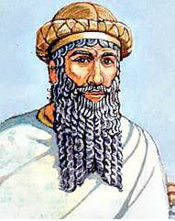
The code states that the punishment for allowing one’s dam to flood everyone’s field is…– 6.9
Sold into slavery
Pay a fine and replace ruined crops
Rebuild the dam
Receive 60 lashes in the public square

Slide 3
“[Sargon] had neither rival nor equal. His splendor, over the lands it diffused. He crossed the sea in the east. In the eleventh year he conquered the western land to its farthest point. He brought it under one authority. He set up his statues there and ferried the west's booty across on barges...”
What is being described in the passage? – 6.9
A city-state
An empire
A civilization
A country

Slide 4
3. After the rule of the Old Babylonians which powerful empire ruled Mesopotamia? 6.9
Sumerians
Akkadians
Egyptians
Assyrians

Slide 5
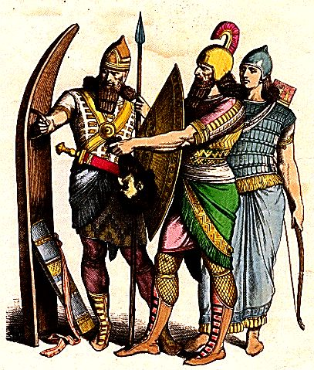
4. The Assyrians made people under the rule of their empire pay tribute, which of the following best explains what tribute is? – 6.13
Incentive program
Bartering system
Oppressive tax system
Government assistance

Slide 6
5. According to this excerpt, what was the tallest point in the city of Nippur? - 6.13
 | a. | bakery
 | b. | Residential area
 | c. | Local businesses
 | d. | ziggurat

Slide 7
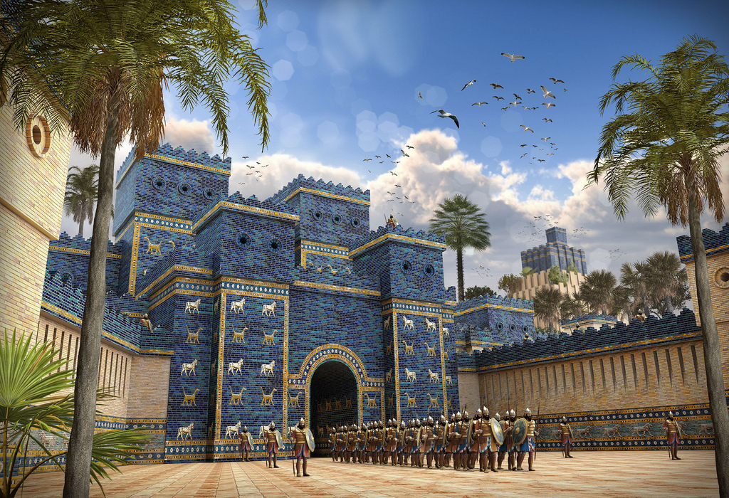
6. Which of the following was considered the greatest city in the Mesopotamian region? - 6.9
Ur
Kish
Babylon
Nippur

Slide 8
7.
6.9

Slide 9
Check your answers

Slide 10
The code states that the punishment for allowing one’s dam to flood everyone’s field is…– 6.9
Sold into slavery
Pay a fine and replace ruined crops
Rebuild the dam
Receive 60 lashes in the public square

Slide 11
“[Sargon] had neither rival nor equal. His splendor, over the lands it diffused. He crossed the sea in the east. In the eleventh year he conquered the western land to its farthest point. He brought it under one authority. He set up his statues there and ferried the west's booty across on barges...”
What is being described in the passage? – 6.9
A city-state
An empire
A civilization
A country

Slide 12
3. After the rule of the Old Babylonians which powerful empire ruled Mesopotamia? 6.9
Sumerians
Akkadians
Egyptians
Assyrians

Slide 13
4. The Assyrians made people under the rule of their empire pay tribute, which of the following best explains what tribute is? – 6.13
Incentive program
Bartering system
Oppressive tax system
Government assistance

Slide 14
5. According to this excerpt, what was the tallest point in the city of Nippur? - 6.13
 | a. | bakery
 | b. | Residential area
 | c. | Local businesses
 | d. | ziggurat

Slide 15
6. Which of the following was considered the greatest city in the Mesopotamian region? - 6.9
Ur
Kish
Babylon
Nippur

Slide 16
7.
6.9

