Slide 1
Checkpoint #15
Number your paper 1-7….Slide times will vary depending of type of question

Slide 2
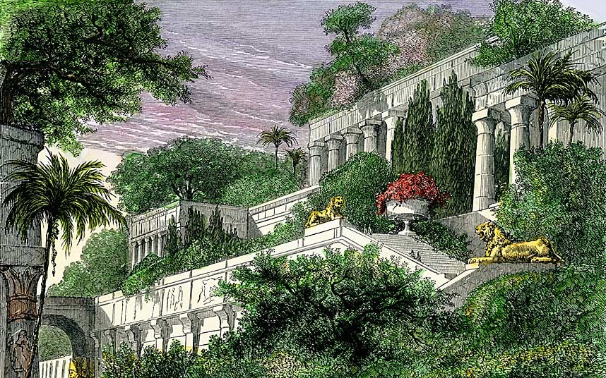
What structure did King Nebuchadnezzar build for his wife? - 6.13
Ziggurat
Hanging Gardens of Babylon
Palace
Pyramid

Slide 3
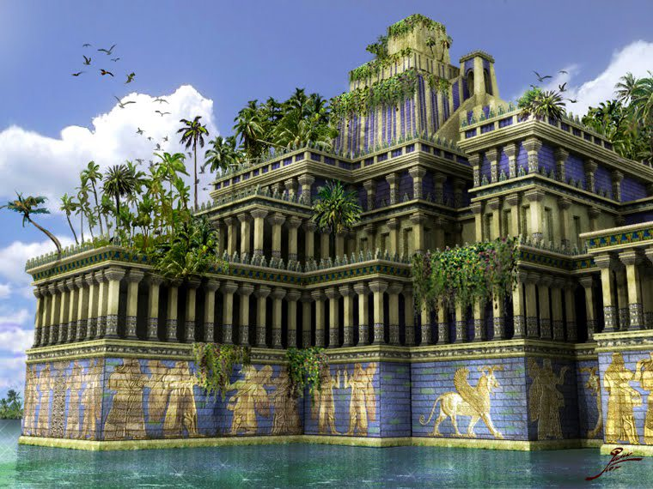
When the Chaldean people entered the region of Mesopotamia they “assimilated” with the cultures that were already present. What does this mean? – 6.9
Attacked
Cooperated
Conformed
Rejected

Slide 4
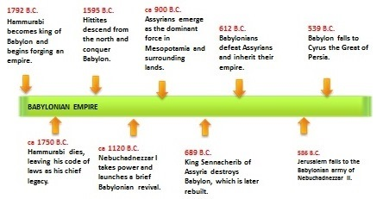
3. What is the general theme of this timeline? 6.9
cooperation
Succession of rulers
Economic activity
innovations

Slide 5
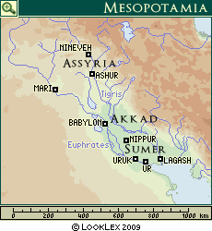
4. Which region of Mesopotamia was Assyria located near? – 6.8
Central
West
South
North

Slide 6
Which city-state did Hammurabi rule from? – 6.9
Babylon
Nippur
Ur
Lagash

Slide 7
6. Which region was Sumer located? - 6.9
Northern Mesopotamia
Central Mesopotamia
Southern Mesopotamia
Western Mesopotamia

Slide 8
7. Which region on the map created the first empire? - 6.9
Sumer
Akkad
Mari
Ashur

Slide 9
Check your answers

Slide 10
What structure did King Nebuchadnezzar build for his wife? - 6.13
Ziggurat
Hanging Gardens of Babylon
Palace
Pyramid

Slide 11
When the Chaldean people entered the region of Mesopotamia they “assimilated” with the cultures that were already present. What does this mean? – 6.9
Attacked
Cooperated
Conformed
Rejected

Slide 12
3. What is the general them of this timeline? 6.9
cooperation
Succession of rulers
Economic activity
innovations

Slide 13
4. Which region of Mesopotamia was Assyria located near? – 6.9
Central
West
South
North

Slide 14
Which city-state did Hammurabi rule from? – 6.9
Babylon
Nippur
Ur
Lagash

Slide 15
6. Which region was Sumer located? - 6.9
Northern Mesopotamia
Central Mesopotamia
Southern Mesopotamia
Western Mesopotamia

Slide 16
7. Which region on the map created the first empire? - 6.9
Sumer
Akkad
Mari
Ashur

