Slide 1
Checkpoints #29
Number 1-7

Slide 2
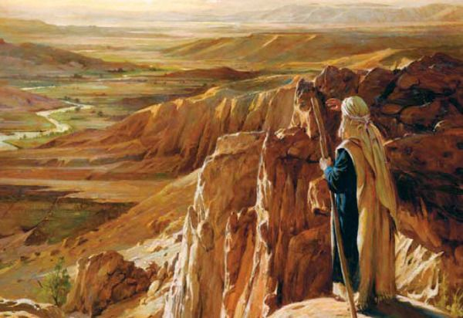
1. Use the box to identify what is being described? – 6.39
Canaan
Palestine
Promised land
Fertile Crescent
Mesopotamia
Israel
Asia minor

Slide 3
6.40
2.

Slide 4
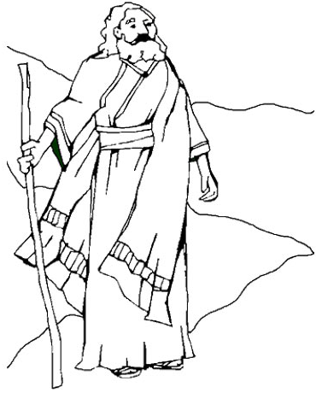
3. If patriarch means father of the family, then what is meant when Abraham is called the patriarch of the Jewish people? - 6.40
The Jewish people can trace their heritage back to him
He was the founder of monotheistic thought
He was Israel’s first king
He is the founder of the Hebrew Bible

Slide 5
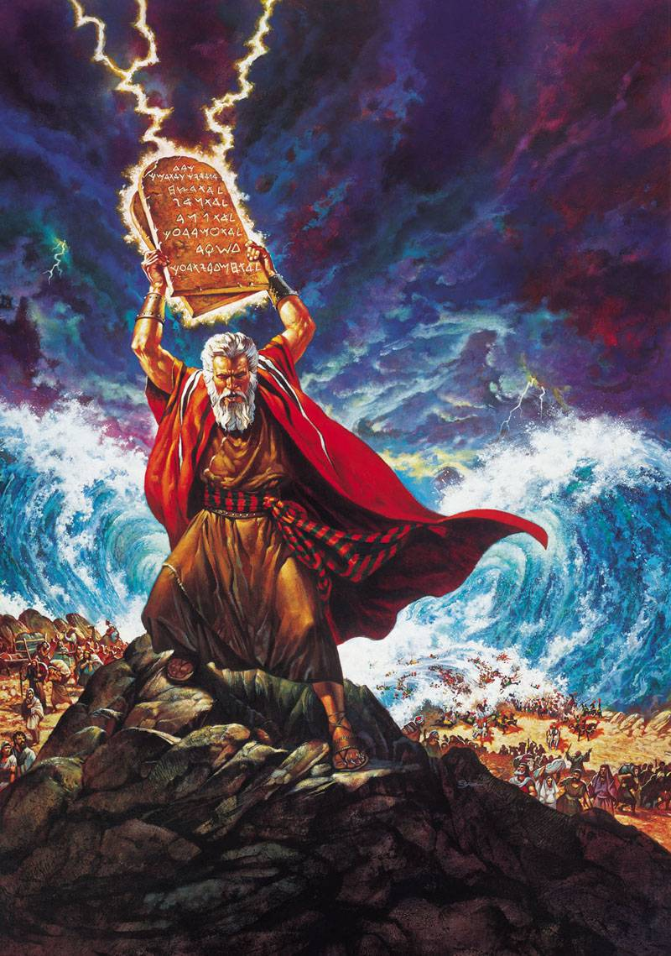
4. Who is being described in the box to the right? – 6.40 A. Abraham B. Jacob C. Isaac D. Moses
Was raised in Egyptian household
Led the Exodus from Egypt
Was given the 10 Commandments

Slide 6
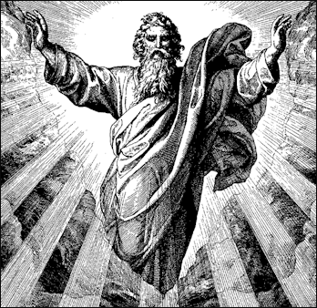
How was Judaism different from the other religions in the surrounding area? – 6.41
It was polytheistic in nature
It was monotheistic in nature
It did not believe in a specific god
It was more of a philosophy than a religion

Slide 7
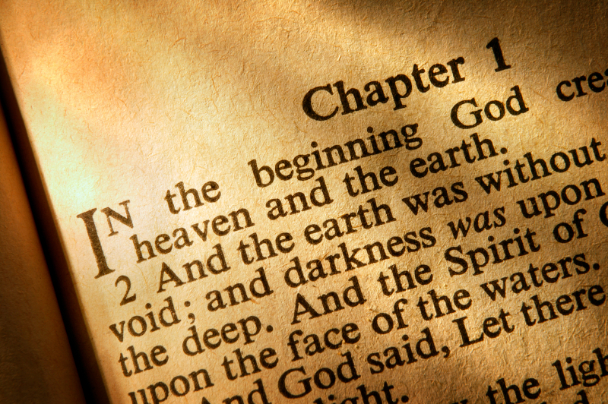
What connection does the Hebrew Bible have with the Christian Bible? - 6.41
The Christian Bible is the Torah
The Christian Bible is the Tanakh
Christians call the Hebrew Bible the Old Testament
Christians call the Hebrew Bible the New Testament

Slide 8
7. What is the central theme to the 10 Commandments? - 6.41
Loyalty to God
Honoring neighbors
Defending territory
Kindness to strangers

Slide 9
Check your answers

Slide 10
1. Use the box to identify what is being described? – 6.39
Canaan
Palestine
Promised land
Fertile Crescent
Mesopotamia
Israel
Asia minor

Slide 11
6.40
2.

Slide 12
3. If patriarch means father of the family, then what is meant when Abraham is called the patriarch of the Jewish people? - 6.40
The Jewish people can trace their heritage back to him
He was the founder of monotheistic thought
He was Israel’s first king
He is the founder of the Hebrew Bible

Slide 13
4. Who is being described in the box to the right? – 6.40 A. Abraham B. Jacob C. Isaac D. Moses
Was raised in Egyptian household
Led the Exodus from Egypt
Was given the 10 Commandments

Slide 14
How was Judaism different from the other religions in the surrounding area? – 6.41
It was polytheistic in nature
It was monotheistic in nature
It did not believe in a specific god
It was more of a philosophy than a religion

Slide 15
What connection does the Hebrew Bible have with the Christian Bible? - 6.41
The Christian Bible is the Torah
The Christian Bible is the Tanakh
Christians call the Hebrew Bible the Old Testament
Christians call the Hebrew Bible the New Testament

Slide 16
7. What is the central theme to the 10 Commandments? - 6.41
Loyalty to God
Honoring neighbors
Defending territory
Kindness to strangers

