Slide 1
Checkpoints #30
Number 1-7

Slide 2
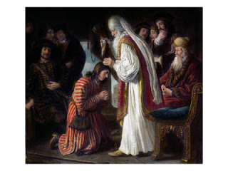
1. Use the box to identify who is being described? – 6.42
1st king of Israel
Anointed by Samuel
Developed a growing hatred for David
Jacob
Joshua
Solomon
Saul

Slide 3
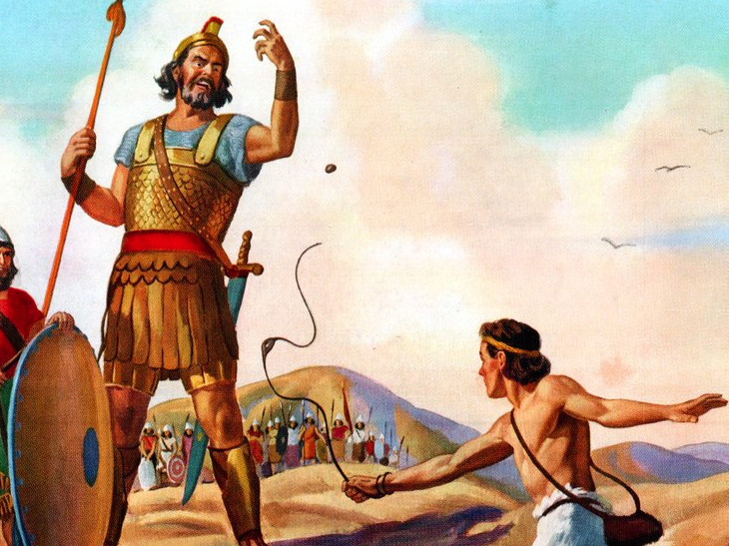
2. Use the box to identify who is being described? – 6.42
Slayed Goliath
Defeated the Philistines
Built the city of Jerusalem
Jacob
Moses
Abraham
David

Slide 4
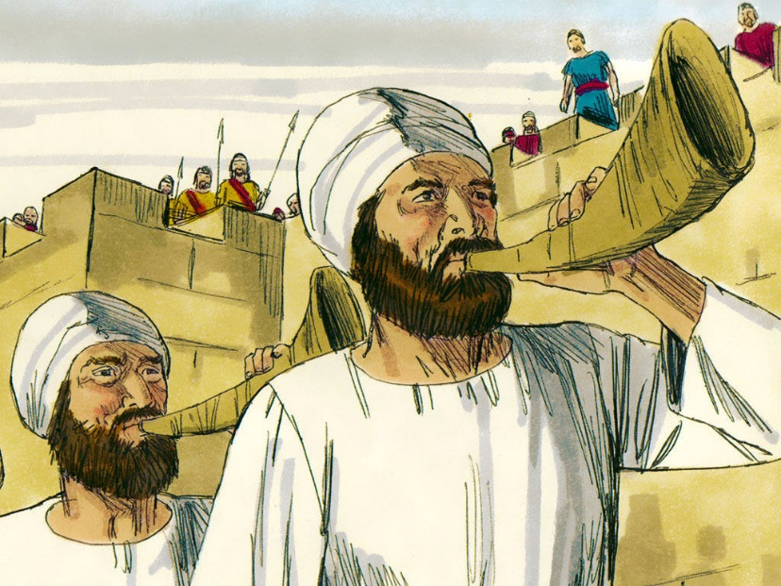
3. Use the box to identify who is being described? – 6.42
Joshua
Moses
Abraham
David
Lead the people into the promise land
Led the Israelites in the battle of Jericho
Started driving Canaanites out of Canaan

Slide 5
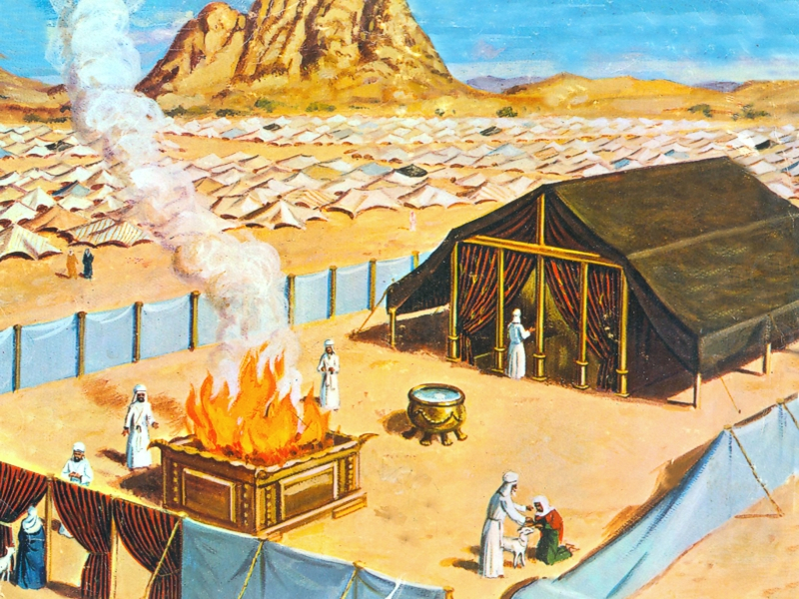
4. Ziggurat is to Mesopotamia as __________ is to Israel. - 6.41
Torah
10 commandments
Tabernacle
Canaan

Slide 6
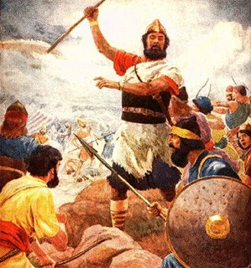
5. Why did the Israelites want to appoint a king over the 12 tribes of Israel? – 6.42 A. To unite and defeat the Philistines B. To seize control of the Phoenician trade routes C. To repay the Egyptians for 400 years of slavery D. To create a diverse culture that shared ideas with the foreigners living within the region.

Slide 7
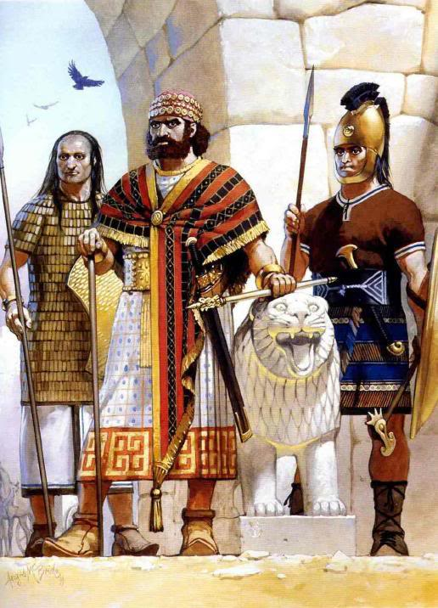
6. What did the Assyrians, Hyksos, Hittites, and Philistines share in common? - 6.40
Military technology
Robust commerce
Uniform alphabet
Monotheistic thought

Slide 8
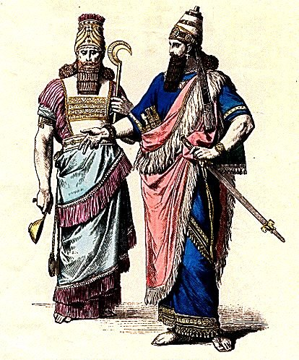
7. Which two emerging empires within the Fertile Crescent gained control of Israel and Judah respectively? – 6.45
Assyrians and Egyptians
Chaldeans and Akkadians
Assyrians and Chaldeans
Chaldeans and Neo-Babylonians

Slide 9
Check your answers

Slide 10
1. Use the box to identify who is being described? – 6.42
1st king of Israel
Anointed by Samuel
Developed a growing hatred for David
Jacob
Joshua
Solomon
Saul

Slide 11
2. Use the box to identify who is being described? – 6.42
Slayed Goliath
Defeated the Philistines
Built the city of Jerusalem
Jacob
Moses
Abraham
David

Slide 12
3. Use the box to identify who is being described? – 6.42
Joshua
Moses
Abraham
David
Lead the people into the promise land
Led the Israelites in the battle of Jericho
Started driving Canaanites out of Canaan

Slide 13
4. Ziggurat is to Mesopotamia as __________ is to Israel. - 6.41
Torah
10 commandments
Tabernacle
Canaan

Slide 14
5. Why did the Israelites want to appoint a king over the 12 tribes of Israel? – 6.42 A. To unite and defeat the Philistines B. To seize control of the Phoenician trade routes C. To repay the Egyptians for 400 years of slavery D. To create a diverse culture that shared ideas with the foreigners living within the region.

Slide 15
6. What did the Assyrians, Hyksos, Hittites, and Philistines share in common? - 6.40
Military technology
Robust commerce
Uniform alphabet
Monotheistic thought

Slide 16
7. Which two emerging empires within the Fertile Crescent gained control of Israel and Judah respectively? – 6.45
Assyrians and Egyptians
Chaldeans and Akkadians
Assyrians and Chaldeans
Chaldeans and Neo-Babylonians

