Slide 1
Checkpoints #31
Number 1-7

Slide 2
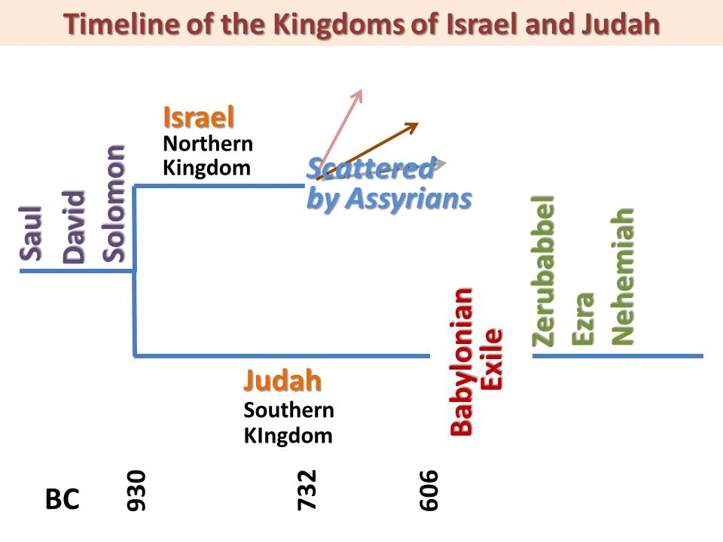
1. Using the timeline, which group of people defeated the northern kingdom? – 6.43
Judah
Israel
Assyrians
Babylonians

Slide 3
2. Using the timeline, which group of people defeated the Southern kingdom? – 6.43
Judah
Israel
Assyrians
Babylonians

Slide 4
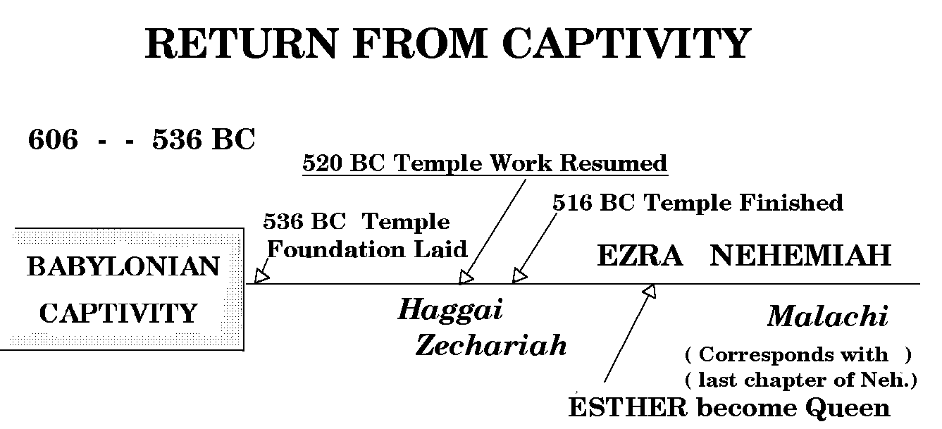
3. Using the timeline, how long was the Babylonian Captivity? – 6.43
7 years
17 years
70 years
100 years

Slide 5
4. What is the name given to the people who trace their ancestry back to the kingdom of Judah? – 6.43
Samaritans
Jews
Israelites
Greeks

Slide 6
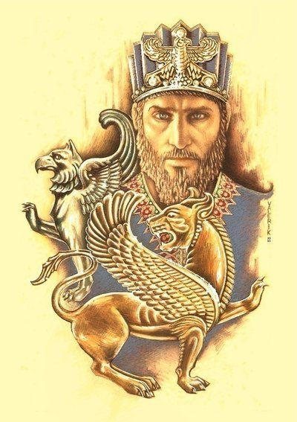
5. Which group of people conquered the Neo-Babylonians and allowed the Jews to return to Judah? – 6.43
Persians
Assyrians
Egyptians
Greeks

Slide 7
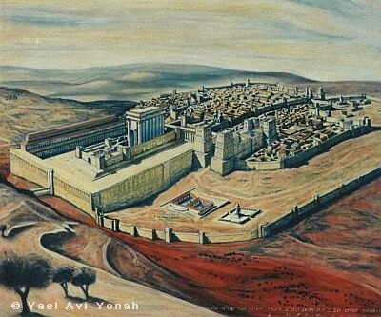
6. After the Jews returned to Judah from the Babylonian captivity what did they began construction on? – 6.43
Walls of Jericho
2nd Temple in Jerusalem
Reestablishing the Northern kingdom
Rebuilding the tabernacle

Slide 8
7. What was a restriction the Persians placed upon the people living in Judah? – 6.43
Not allowed to trade
No access for travel
Slavery
Could not have a king or their own government

Slide 9
Check your answers

Slide 10
1. Using the timeline, which group of people defeated the northern kingdom? – 6.43
Judah
Israel
Assyrians
Babylonians

Slide 11
2. Using the timeline, which group of people defeated the Southern kingdom? – 6.43
Judah
Israel
Assyrians
Babylonians

Slide 12
3. Using the timeline, how long was the Babylonian Captivity? – 6.43
7 years
17 years
70 years
100 years

Slide 13
4. What is the name given to the people who trace their ancestry back to the kingdom of Judah? – 6.43
Samaritans
Jews
Israelites
Greeks

Slide 14
5. Which group of people conquered the Neo-Babylonians and allowed the Jews to return to Judah? – 6.43
Persians
Assyrians
Egyptians
Greeks

Slide 15
6. After the Jews returned to Judah from the Babylonian captivity what did they began construction on? – 6.43
Walls of Jericho
2nd Temple in Jerusalem
Reestablishing the Northern kingdom
Rebuilding the tabernacle

Slide 16
7. What was a restriction the Persians placed upon the people living in Judah? – 6.43
Not allowed to trade
No access for travel
Slavery
Could not have a king or their own government

