Slide 1
Checkpoints #32
Number 1-7

Slide 2
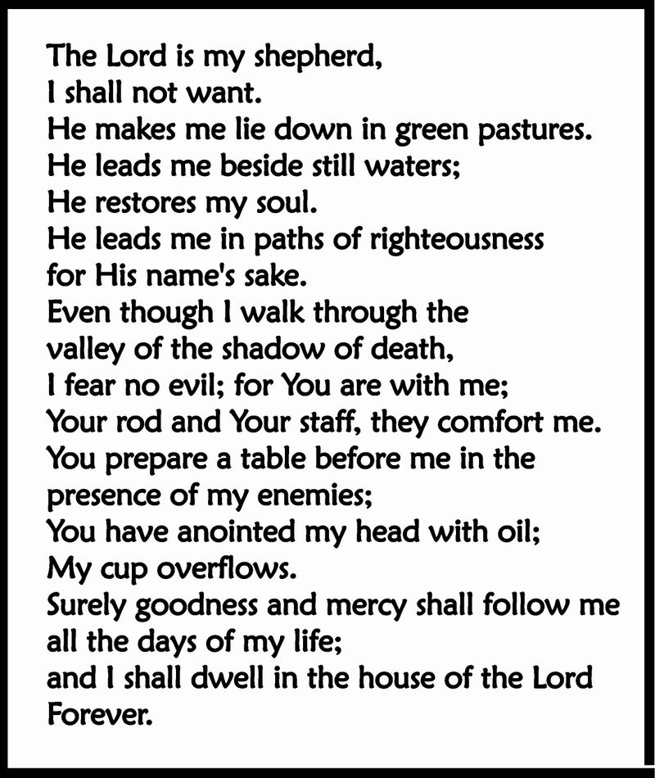
1. Read Psalm 23. What is the theme of this song? – 6.42
Lord’s justice
Lord’s Patience
Lord’s guidance
Lord’s revenge

Slide 3
2. Read the proverb by Solomon, what is his view about rich and poor? – 6.42
Better to be rich and unjust
Better to be poor and unjust
Better to be rich and established
Better to be poor and righteous

Slide 4
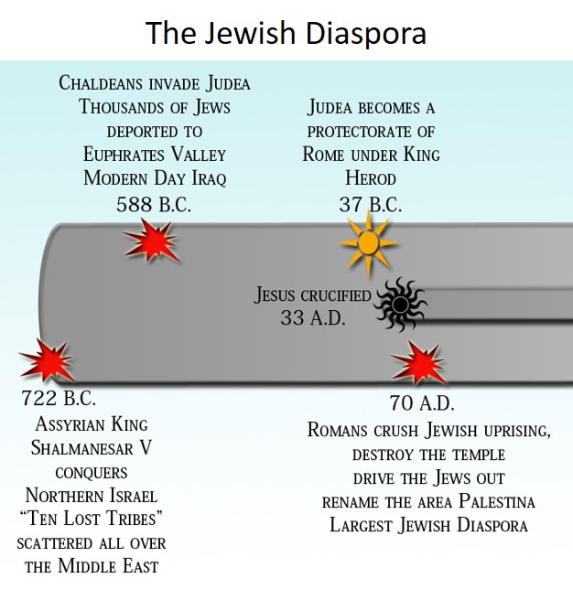
3. Which group of people were responsible for the largest diaspora? – 6.43
Chaldeans
Assyrians
Persians
Romans

Slide 5
4. Which king conquered the Northern tribes? – 6.43
Judah
Shalmanesar V
Caesar
Nebuchadnezzer

Slide 6
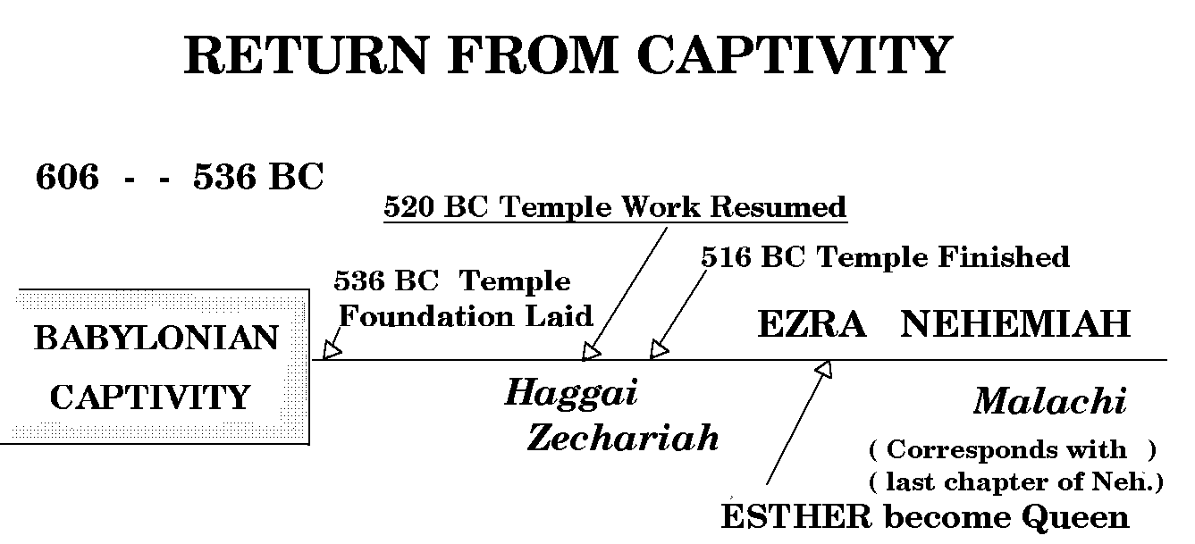
5. Which date marks the completion of the 2nd temple? – 6.43
520BC
606BC
536BC
516BC

Slide 7
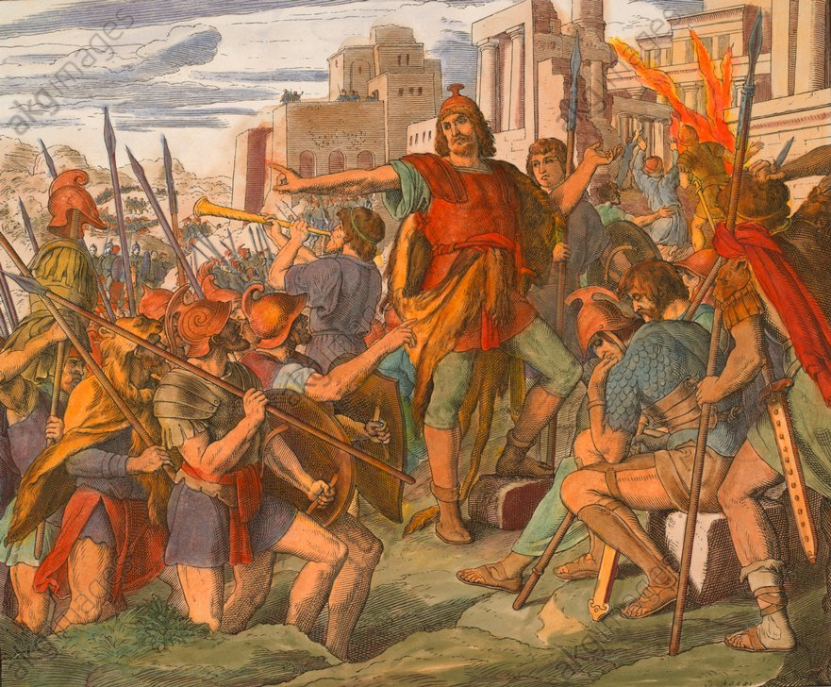
6. Who is being described in the box? – 6.44
Rebelled against the Seleucids
Regained control of the temple
Removed statues from the temple
Judas Maccabeus
Alexander the Great
David
Solomon

Slide 8
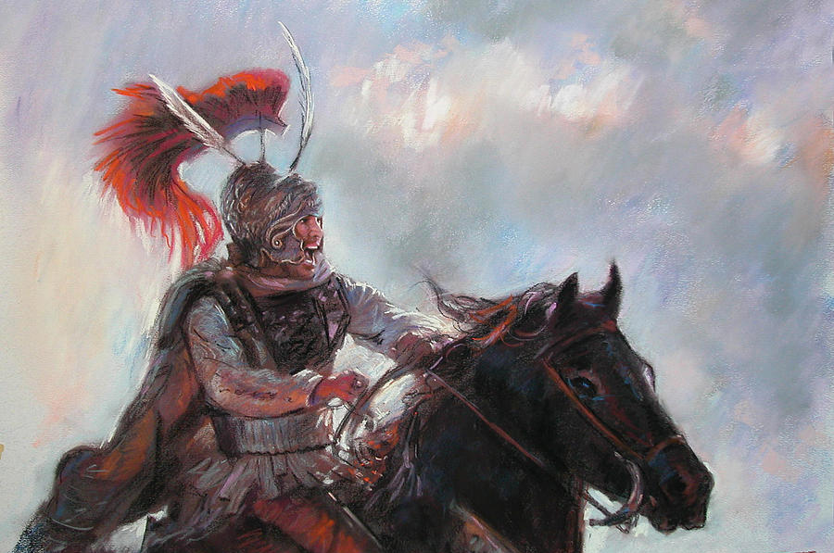
7. Who conquered the Persian empire in 331BC? – 6.43
Alexander the Great
Ramses the Great
Sargon the Great
Asoka the Great

Slide 9
Check your answers

Slide 10
1. Read Psalm 23. What is the theme of this song? – 6.42
Lord’s justice
Lord’s Patience
Lord’s guidance
Lord’s revenge

Slide 11
2. Read the proverb by Solomon, what is his view about rich and poor? – 6.42
Better to be rich and unjust
Better to be poor and unjust
Better to be rich and established
Better to be poor and righteous

Slide 12
3. Which group of people were responsible for the largest diaspora? – 6.43
Chaldeans
Assyrians
Persians
Romans

Slide 13
4. Which king conquered the Northern tribes? – 6.43
Judah
Shalmanesar V
Caesar
Nebuchadnezzer

Slide 14
5. Which date marks the completion of the 2nd temple? – 6.43
520BC
606BC
536BC
516BC

Slide 15
6. Who is being described in the box? – 6.44
Rebelled against the Seleucids
Regained control of the temple
Removed statues from the temple
Judas Maccabeus
Alexander the Great
David
Solomon

Slide 16
7. Who conquered the Persian empire in 331BC? – 6.43
Alexander the Great
Ramses the Great
Sargon the Great
Asoka the Great

