Slide 1
Checkpoint #5
Number your paper 1-7….Slide times will vary depending of type of question

Slide 2
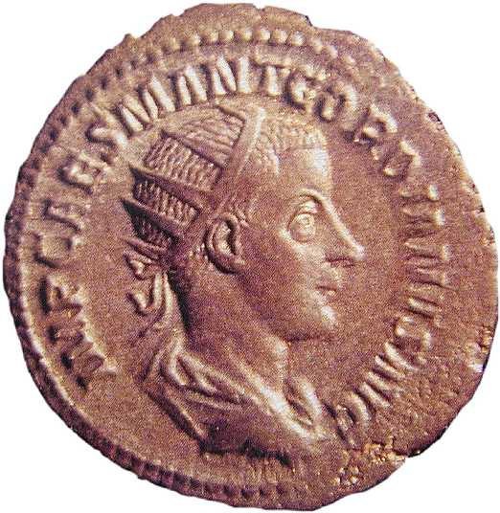
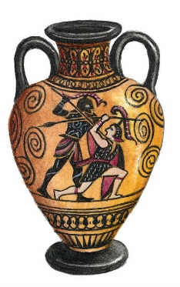
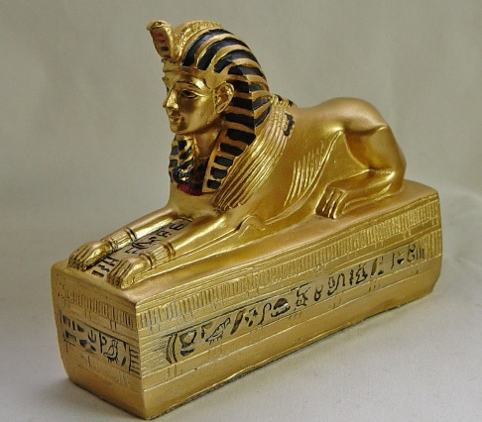
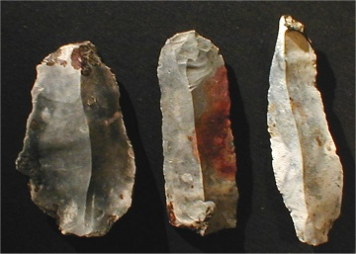
Which of the following is an artifact from the Paleolithic Age? – 6.2
b.
c. d.

Slide 3
2. The Paleolithic, Mesolithic, and Neolithic are best described as … 6.7
Prehistoric
Ancient
Classical
Renaissance
Paleolithic Age
Mesolithic Age
Neolithic Age

Slide 4
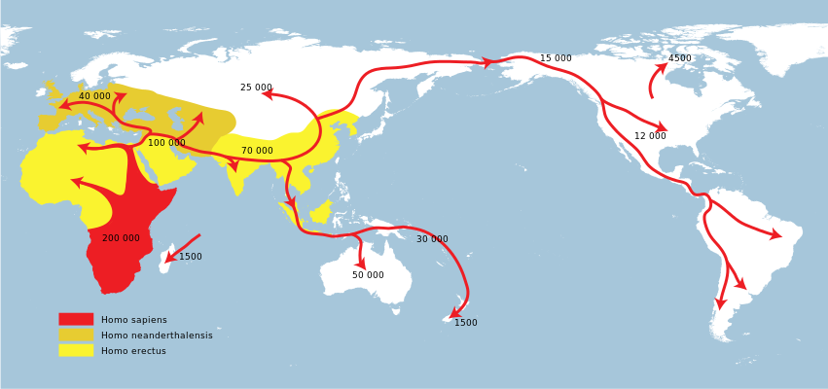
3. When did humans reach North America?
a. 25,000 years ago b. 50,000 years ago c. 70,000 years ago d. 15,000 years ago

Slide 5
4. Which choice best describes the reason people call it “the Stone Age?” - 6.2
The technology available
Type of communication
Cultural traits
Religious beliefs

Slide 6
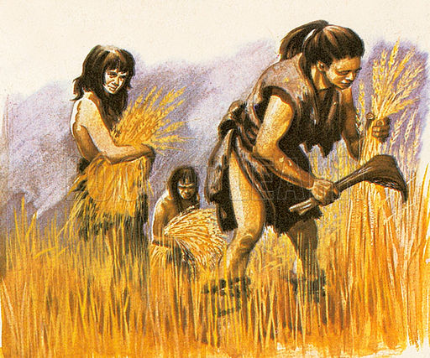
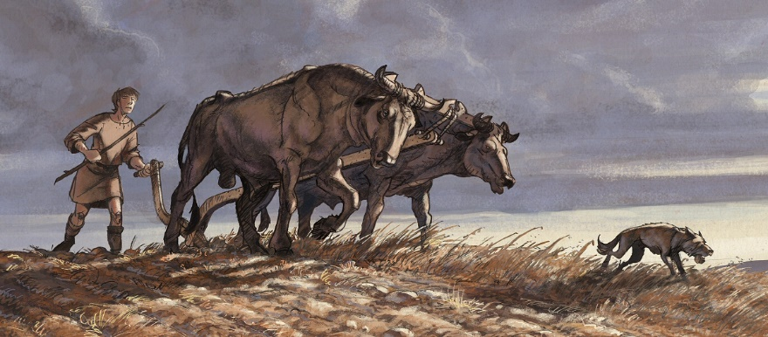
5. Which innovation would be considered the oldest “Stone Age” innovation? – 6.2
B
A
C
D

Slide 7
6. Which “Age” were permanent shelters established? - 6.2
Paleolithic
Mesolithic
Neolithic
Paleolithic Age
Mesolithic Age
Neolithic Age

Slide 8
7. What word best describes the picture? – 6.2
Hunting and gathering societies
Domestication of animals
Development of religion
Dairy farming

Slide 9
Check your answers

Slide 10
Which of the following is an artifact from the Paleolithic Age? – 6.2
b.
c. d.

Slide 11
2. The Paleolithic, Mesolithic, and Neolithic are best described as … 6.7
Prehistoric
Ancient
Classical
Renaissance
Paleolithic Age
Mesolithic Age
Neolithic Age

Slide 12
3. When did humans reach North America?
a. 25,000 years ago b. 50,000 years ago c. 70,000 years ago d. 15,000 years ago

Slide 13
4. Which choice best describes the reason people call it “the Stone Age?” - 6.2
The technology available
Type of communication
Cultural traits
Religious beliefs

Slide 14
5. Which innovation would be considered the oldest “Stone Age” innovation? – 6.2
B
A
C
D

Slide 15
6. Which “Age” were permanent shelters established? - 6.2
Paleolithic
Mesolithic
Neolithic
Paleolithic Age
Mesolithic Age
Neolithic Age

Slide 16
7. What word best describes the picture? – 6.2
Hunting and gathering societies
Domestication of animals
Development of religion
Dairy farming

