Slide 1
Checkpoint #6
Number your paper 1-7….Slide times will vary depending of type of question

Slide 2
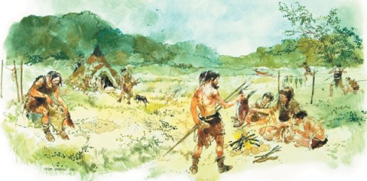
Which of the following is one way early man survived in colder climates during the Paleolithic Age? – 6.4
Developed communication skills
Used animal skins for clothing
Domesticated animals
Stored food for the winters

Slide 3
2. What best describes how the tools changed over time during the Paleolithic Age … 6.2
They became much larger
They were less complex
They weren’t as durable
They were smaller and sharper

Slide 4
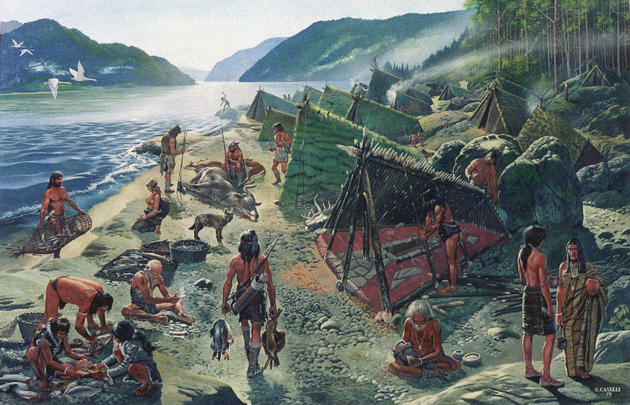
3. Which of the following would best describe a hunter gatherers lifestyle? … 6.2
They were farming societies
They domesticated large animals
They were nomadic
They built permanent shelters
“A hunter-gatherer or forager society is one in which most or all food is obtained from wild plants and animals, in contrast to agricultural societies, which rely mainly on domesticated species.
Hunting and gathering was humanity's first and most successful adaptation, occupying at least 90 percent of human history, and until 12,000 years ago, all humans lived this way,"^{[2]} but following the invention of agriculture, hunter-gatherers have been displaced or conquered by farming or pastoralist groups in most parts of the world.”

Slide 5
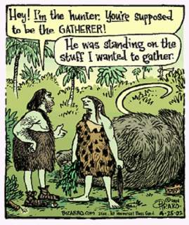
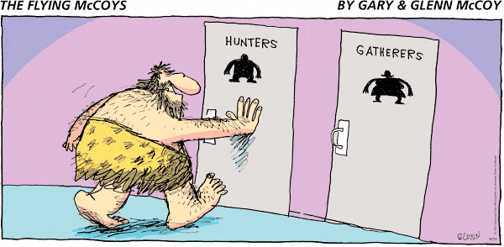
4. What does the comics suggest about the roles of men and women in early hunter gatherer societies?” - 6.2
Women were the hunters
Men were the gathers
Women made all the decisions
Men were the hunters

Slide 6
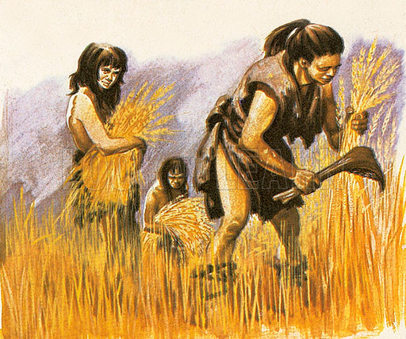
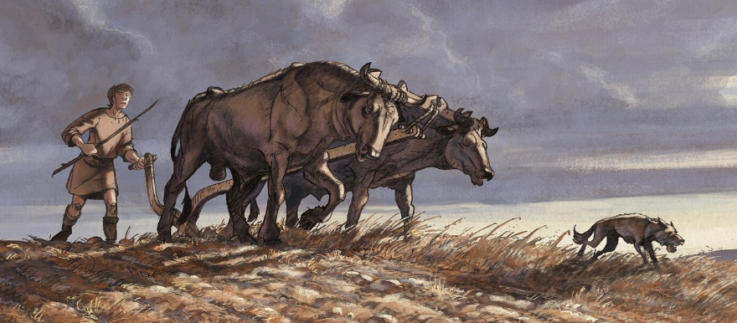
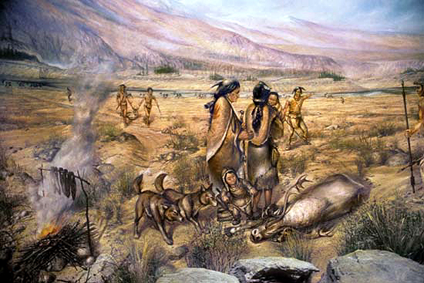
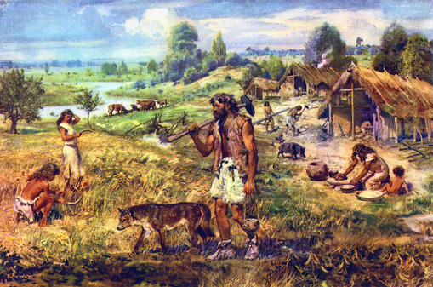
5. Which picture best represents nomadic activity? – 6.2
B
A
C
D

Slide 7
6. Which type of stone technology helped advance early man during the Paleolithic Age? - 6.2
Iron Ore
Coal
Copper
Flint

Slide 8
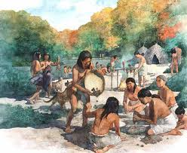
7. Early humans of the Paleolithic Age lived in groups or bands consisting of about ________________. – 6.2
5 – 10 people
20 - 30 people
Groups larger than 200
Groups larger than 500

Slide 9
Check your answers

Slide 10
Which of the following is one way early man survived in colder climates during the Paleolithic Age? – 6.4
Developed communication skills
Used animal skins for clothing
Domesticated animals
Stored food for the winters

Slide 11
2. What best describes how the tools changed over time during the Paleolithic Age … 6.2
They became much larger
They were less complex
They weren’t as durable
They were smaller and sharper

Slide 12
3. Which of the following would best describe a hunter gatherers lifestyle? … 6.2
They were farming societies
They domesticated large animals
They were nomadic
They built permanent shelters
“A hunter-gatherer or forager society is one in which most or all food is obtained from wild plants and animals, in contrast to agricultural societies, which rely mainly on domesticated species.
Hunting and gathering was humanity's first and most successful adaptation, occupying at least 90 percent of human history, and until 12,000 years ago, all humans lived this way,"^{[2]} but following the invention of agriculture, hunter-gatherers have been displaced or conquered by farming or pastoralist groups in most parts of the world.”

Slide 13
4. What does the comics suggest about the roles of men and women in early hunter gatherer societies?” - 6.2
Women were the hunters
Men were the gathers
Women made all the decisions
Men were the hunters

Slide 14
5. Which picture best represents nomadic activity? – 6.2
B
A
D
C

Slide 15
6. Which type of stone technology helped advance early man during the Paleolithic Age? - 6.2
Iron Ore
Coal
Copper
Flint

Slide 16
7. Early humans of the Paleolithic Age lived in groups or bands consisting of about ________________. – 6.2
5 – 10 people
20 - 30 people
Groups larger than 200
Groups larger than 500

