Slide 1
Chapter 8
review

Slide 2
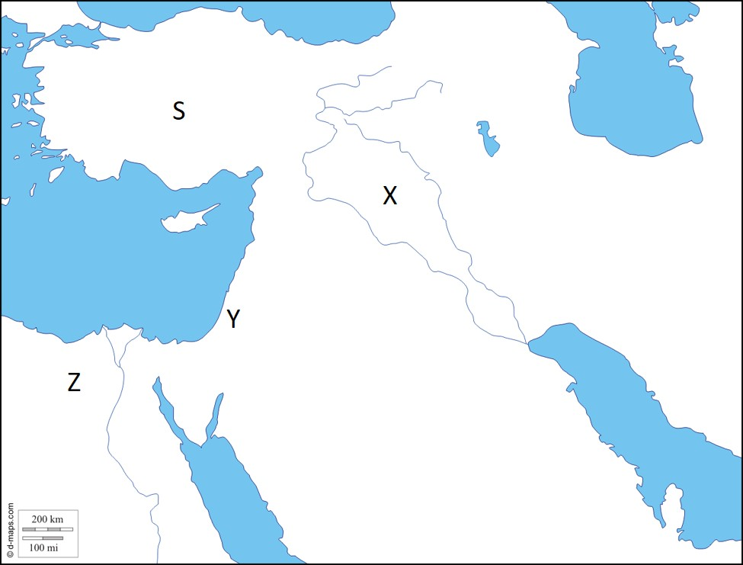
Locate Israel
Y
What was the promise land called?
Canaan

Slide 3
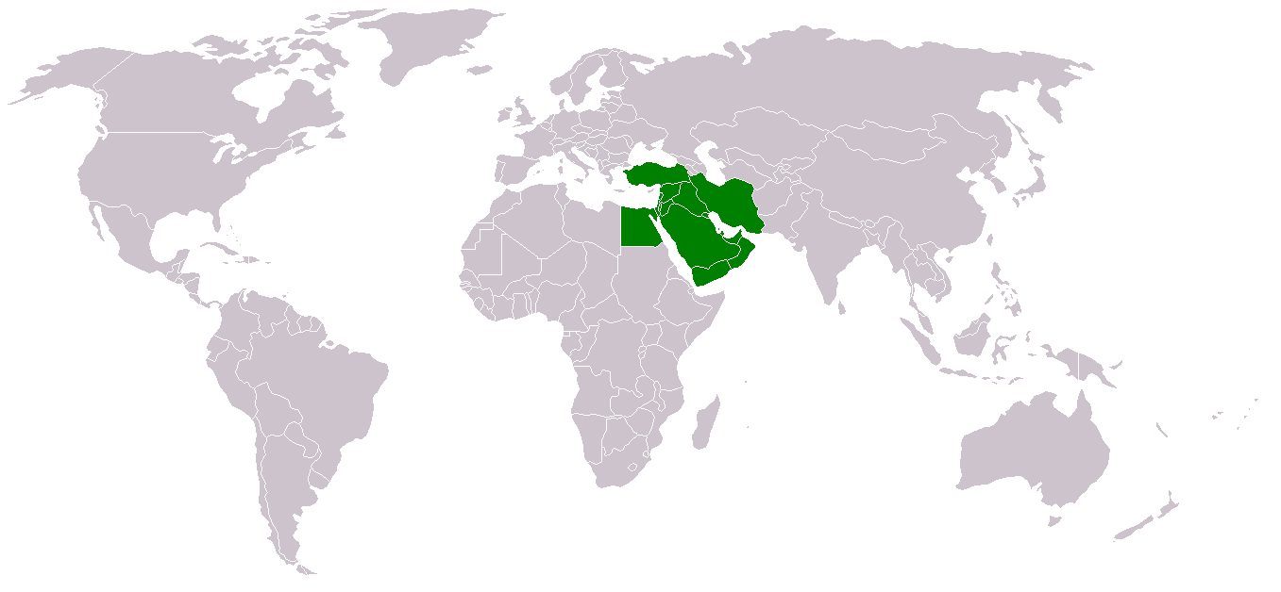
What region is Israel located within?
Middle East

Slide 4
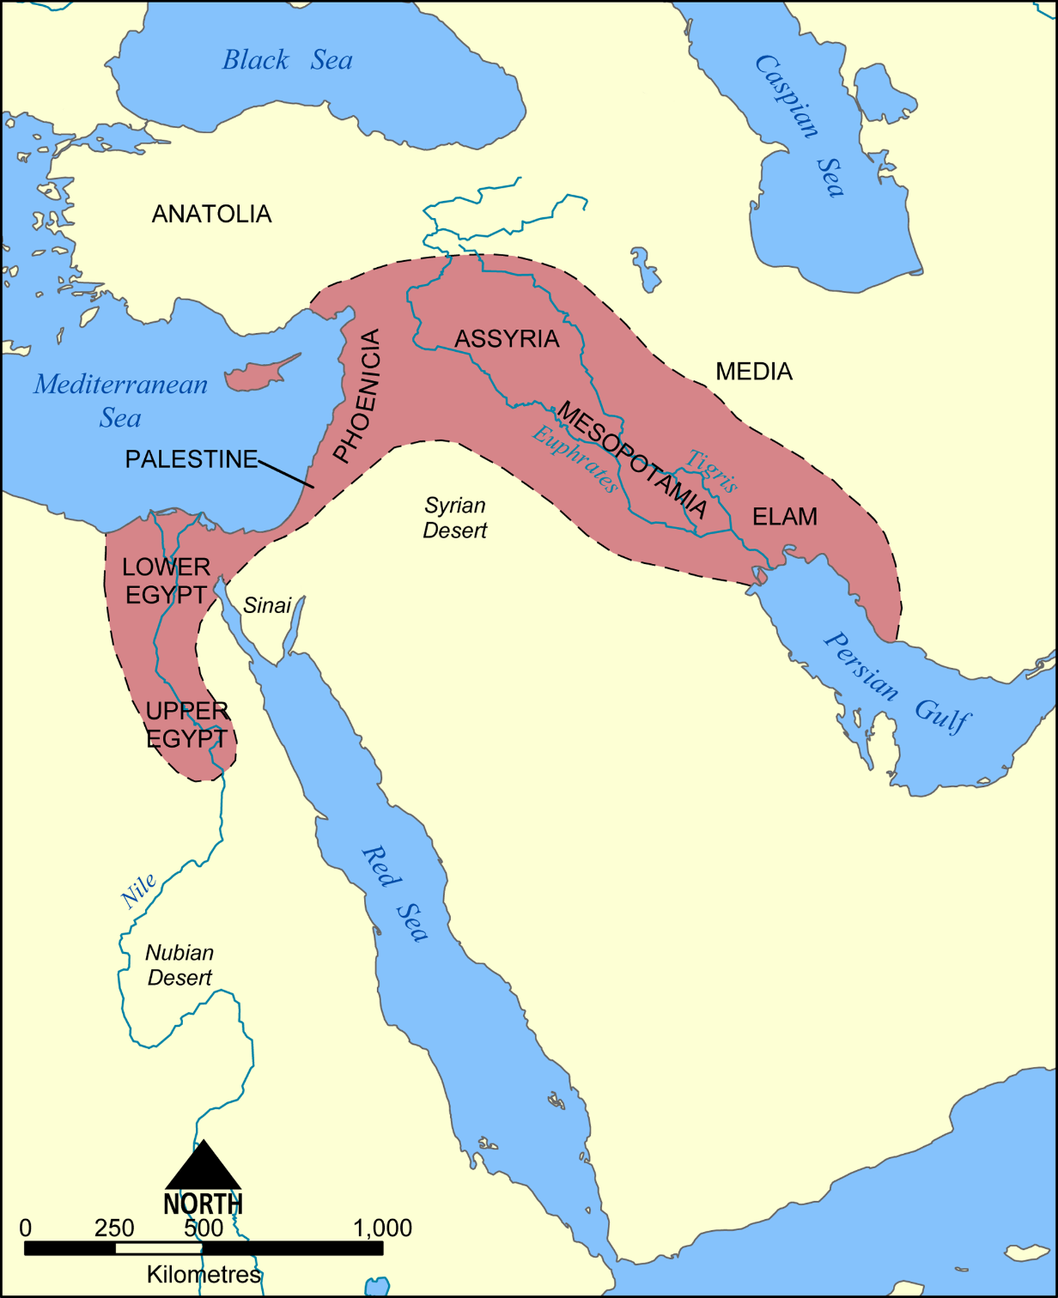
What smaller region is Israel located within?
Fertile Crescent

Slide 5
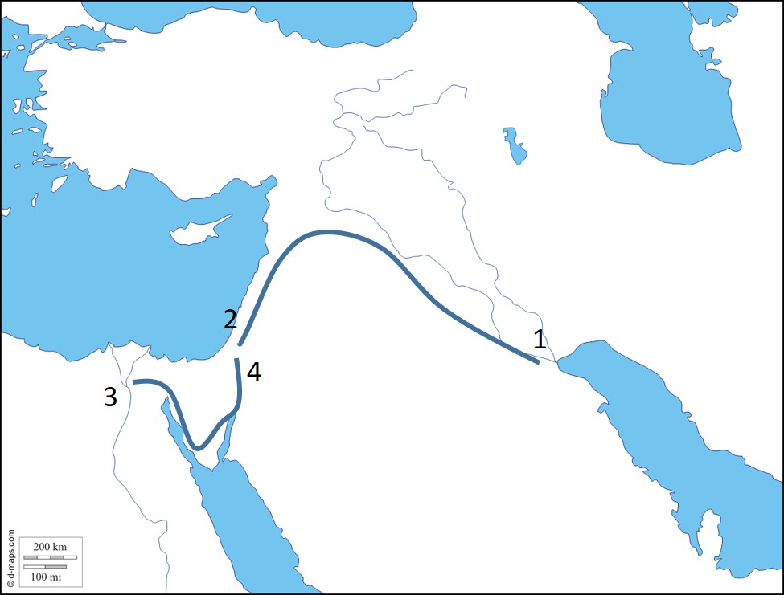
What does line 1 and 2 represent?
Abraham’s migration
What does line 3 and 4 represent?
Moses’s Exodus

Slide 6
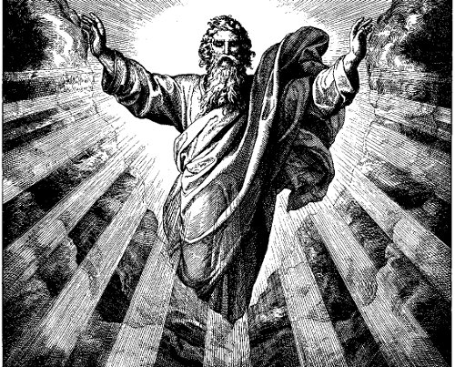
How is Israel’s religion different than the other peoples of the region?
Monotheistic
What does Monotheistic mean?
Belief in one god

Slide 7
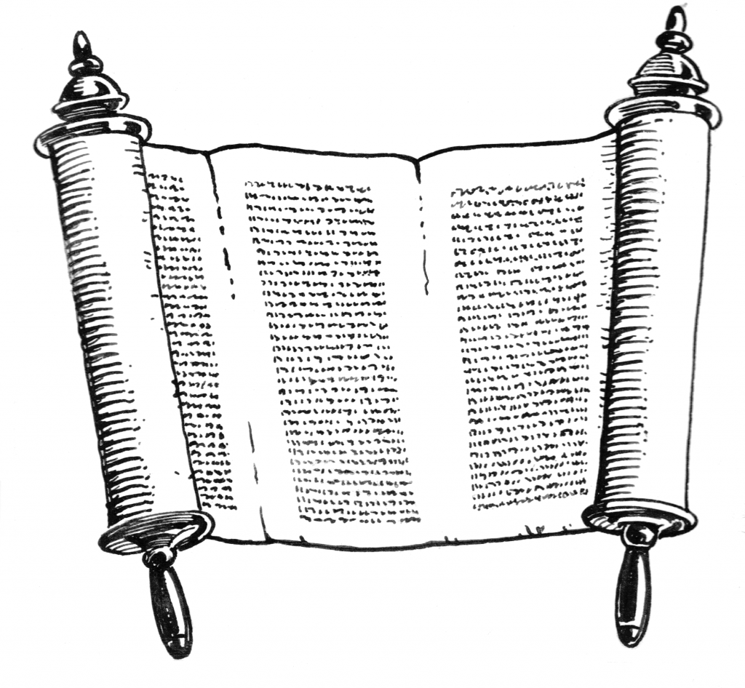
Tanakh
Torah
10 commandments
What is being described?
Hebrew Bible
What is the oldest part of the Hebrew Bible
Torah

Slide 8
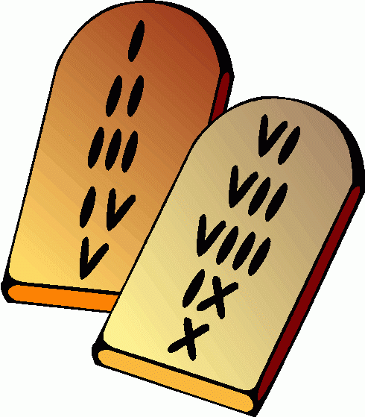
Received by Moses
Found in the Torah
Loyalty to God
What is being described?
10 Commandments

Slide 9
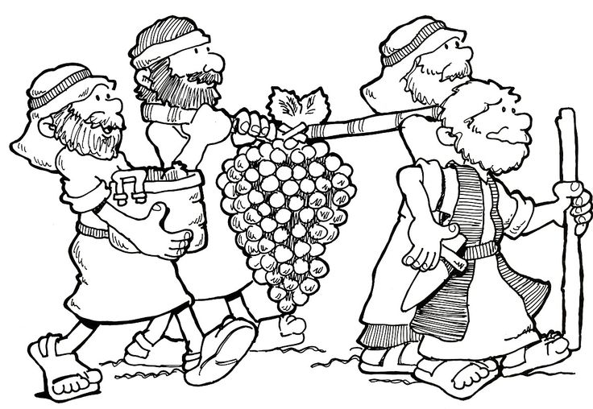
Why did the 12 tribes want a king?
Who was the first king of Israel?
Unify and defeat the Philistines
Saul
The 2nd?
David
3rd ?
Solomon

Slide 10
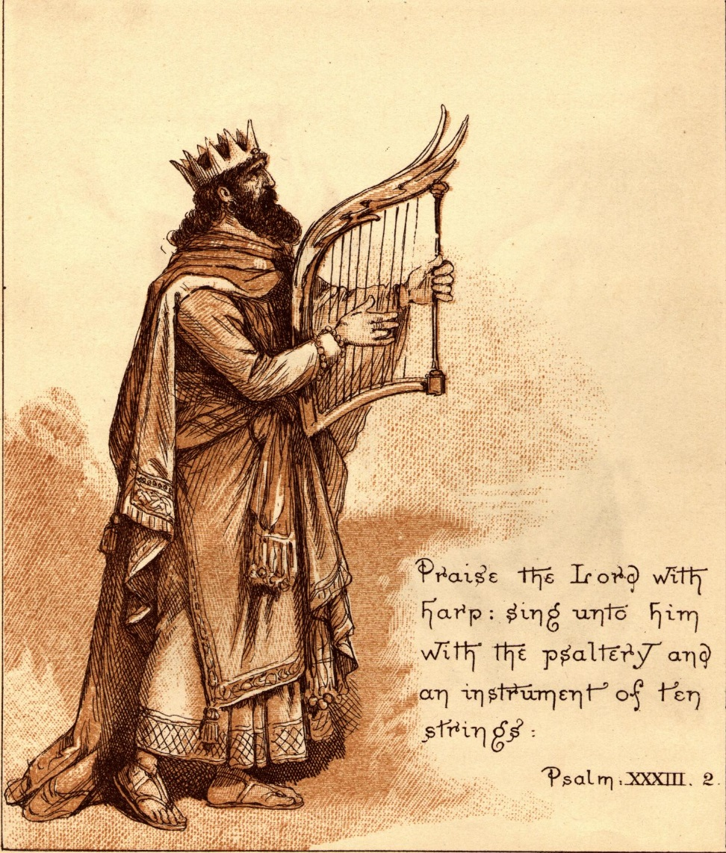
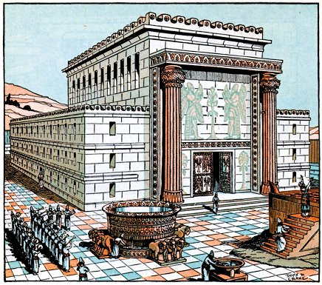
How founded the city of Jerusalem?
Who built the 1st temple?
David
Solomon

Slide 11
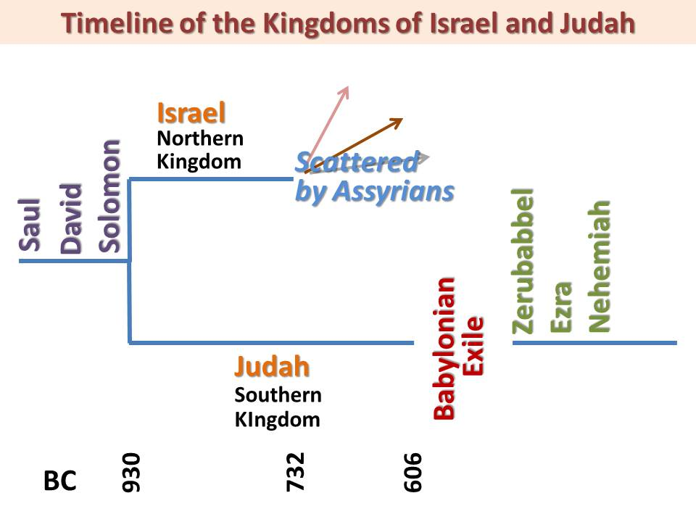
Who defeated the Northern Kingdom?
Who exiled the Southern Kingdom?
Assyrians
Babylonians
What’s the other name for Babylonians?
Chaldeans

Slide 12
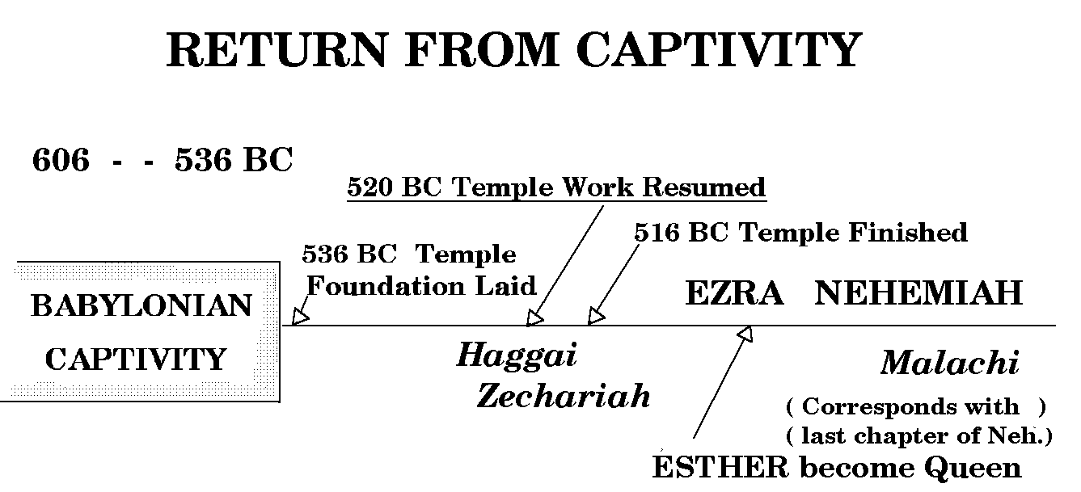
How long was the Babylonian captivity?
What was built when the Jews returned to Judah?
70 years
2nd temple

Slide 13
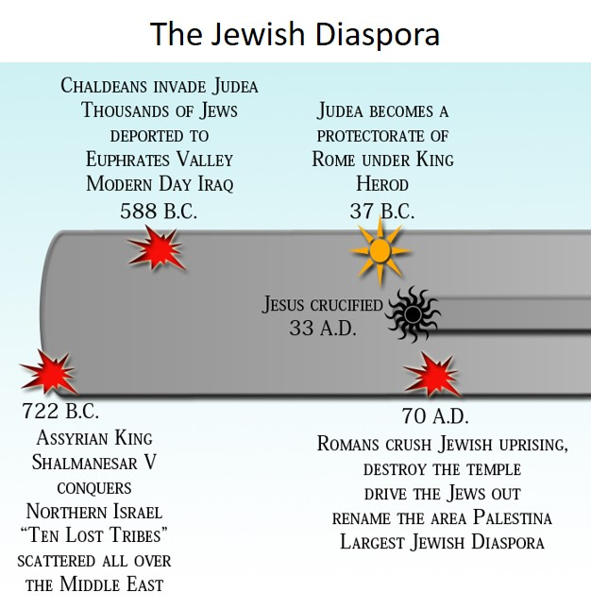
Who renamed the region Palestina?
What does Palestina reference?
Romans
Philistines

Slide 14
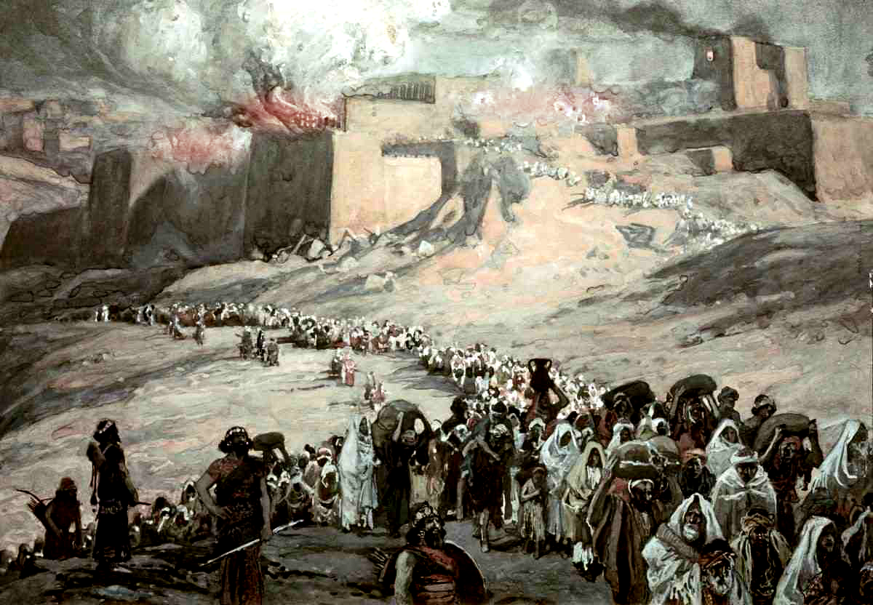
What best describes the word Diaspora?
Scattering of people

